Slide 1
Frequency analysis

Slide 2
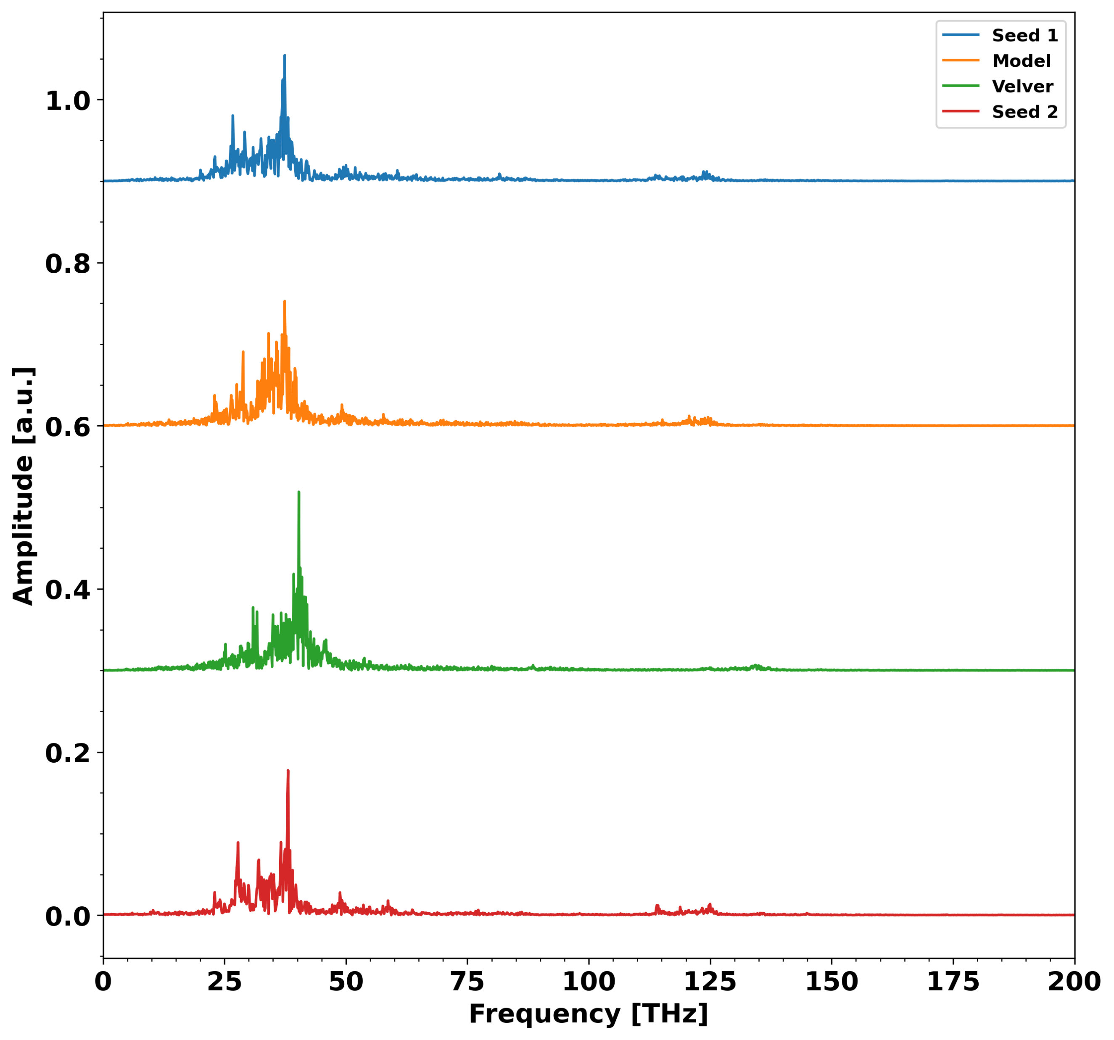
C-O-H angle

Slide 3
RNN model

Slide 4
Predicted forces
RNN
Descriptor
Atomic numbers
Forces

Slide 5
Training data
Val data
Test data
Trajectory
~15000 time steps

Slide 6
All data series were scaled to be between 0 and 1
Atomic numbers were divided by 8
Number of GRU layer and number of hidden nodes were optimized
Loss function is squared error
Uses Adam optimizer
Optimization only stops when std of val error is below threshold

Slide 7
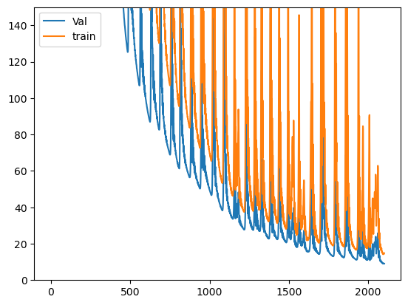

Slide 8
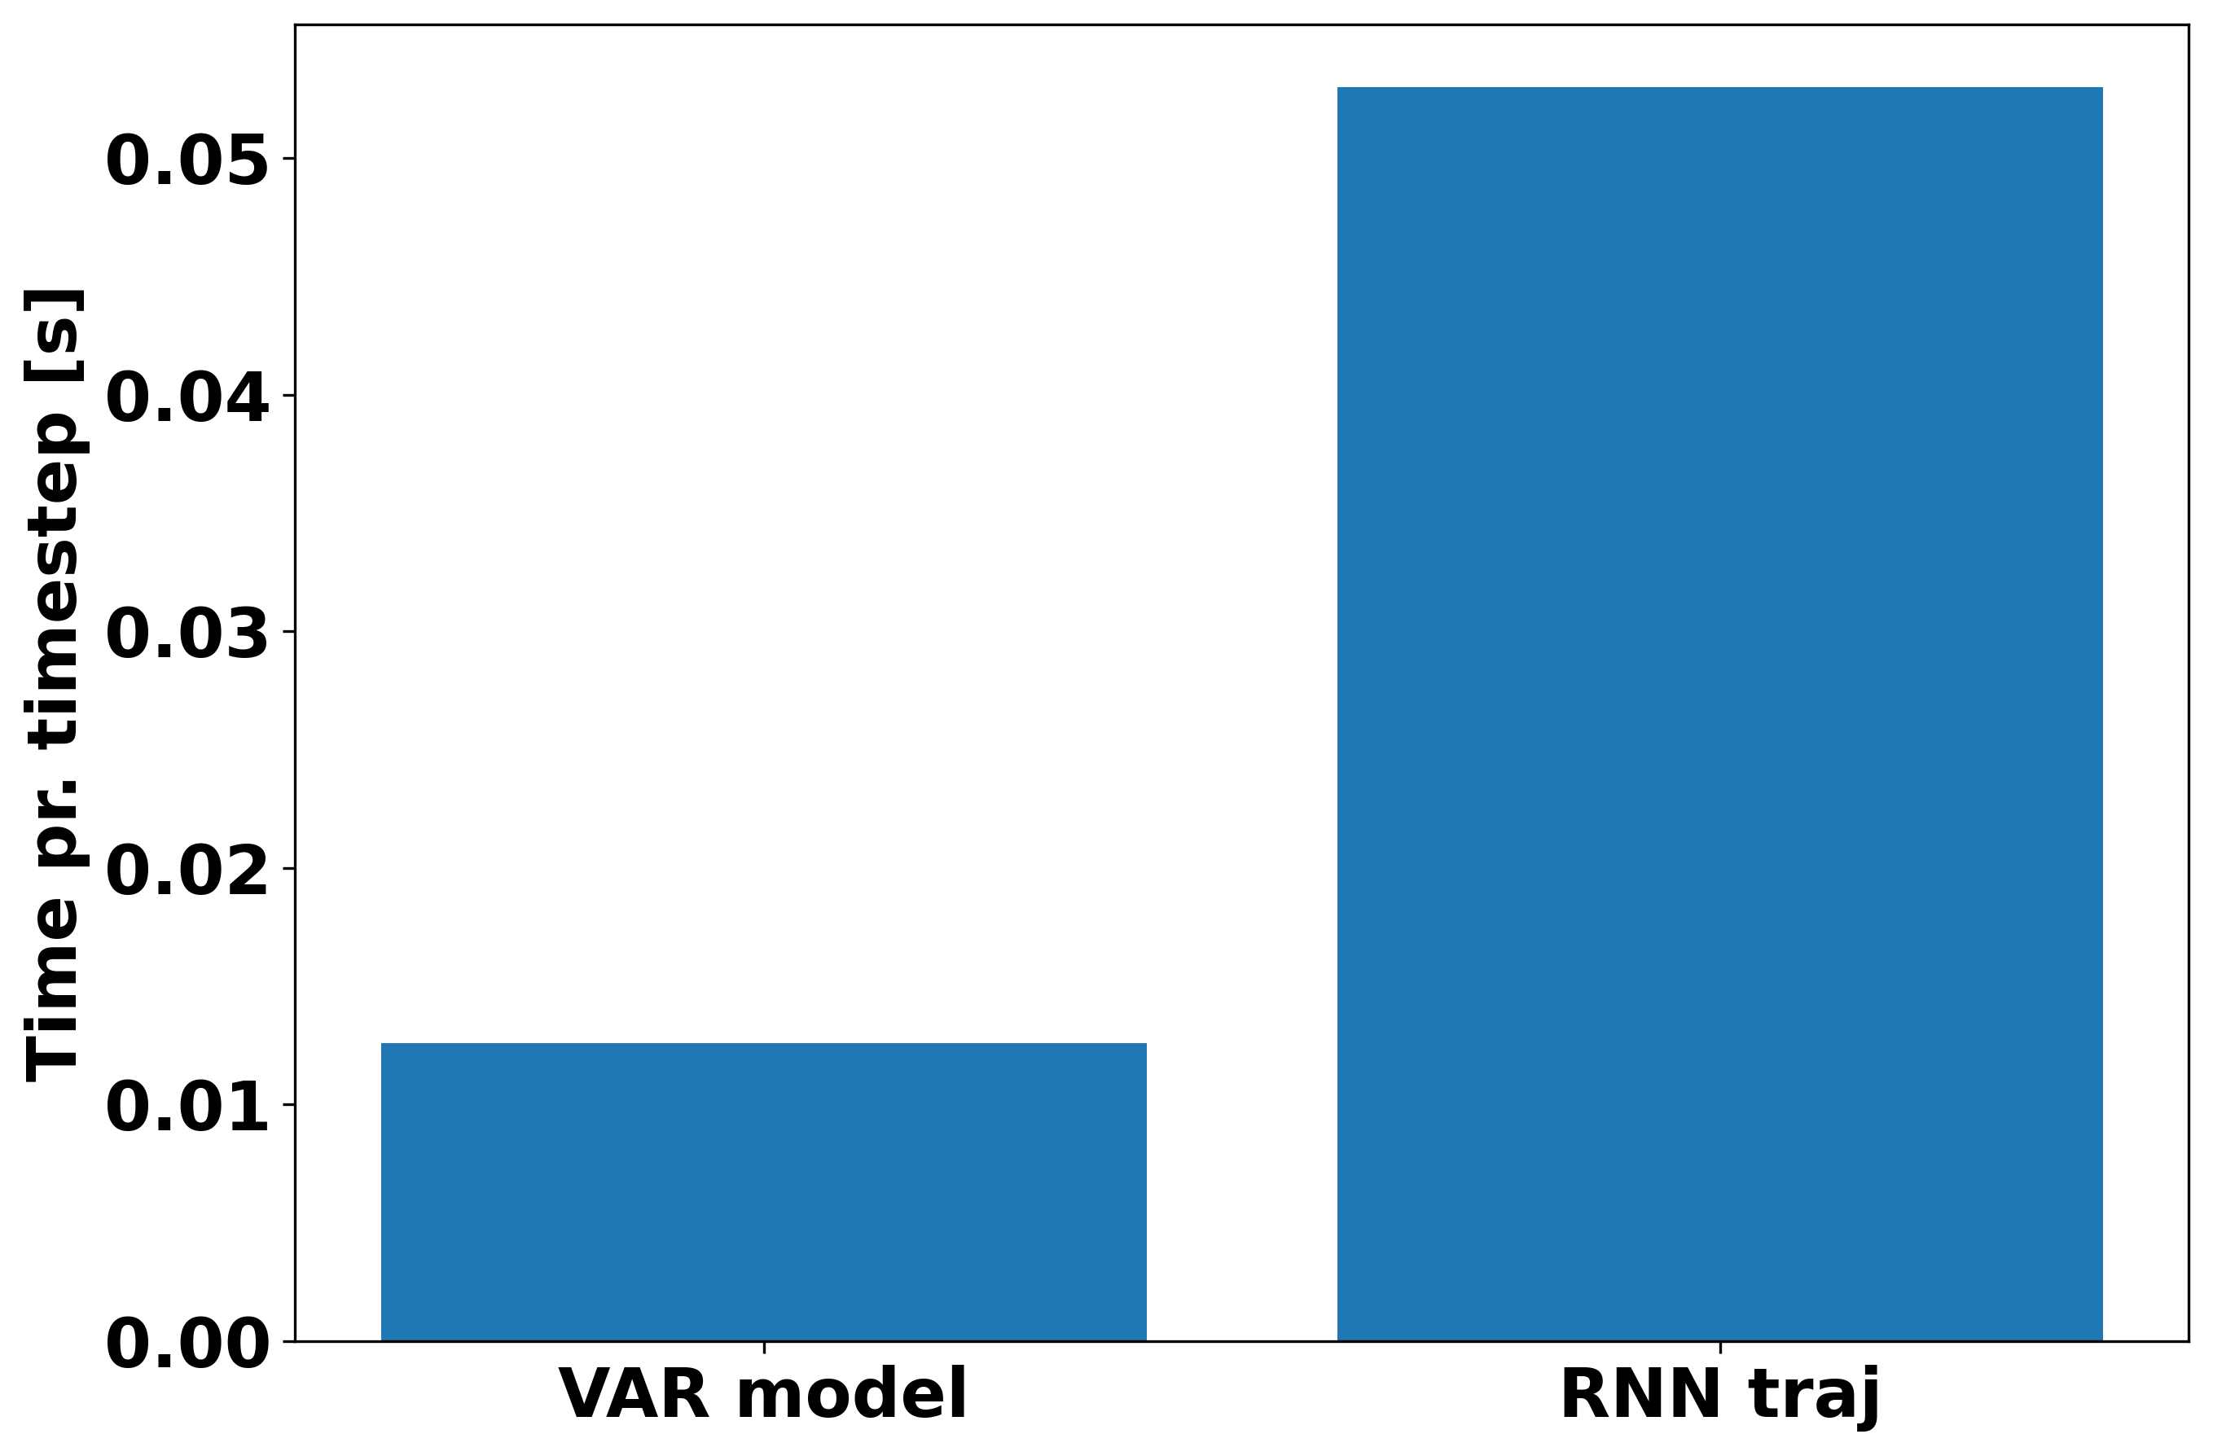

Slide 9
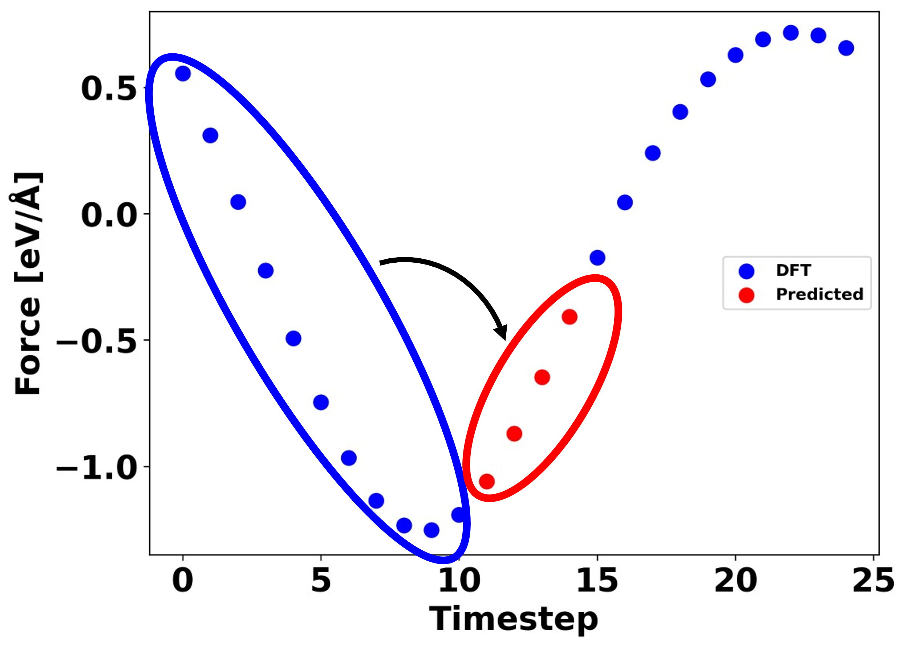
Window RNN

Slide 10
